Slide 1
Automated system for Material Return from Customer PSCS215
PIP2001 Capstone Project
Final Review
Batch Number: 133
Roll Number | Student Name
20211CSE0719 | G BHARATH KALYAN
20211CSE0727 | NAMRATA SHANKAR NIDONI
20211CSE0717 | S VAMSI CHAITHANYA
20211CSE0720 | G DILEEP KUMAR REDDY
Under the Supervision of,
Dr .Serin V Simpson(Reviwer)
Dr .Venkataravana Nayak(Guide)
Assistant Professor
School of Computer Science and Engineering
Presidency University
Name of the Program: CSE
Name of the HoD: Dr. Asif Mohammed
Name of the Program Project Coordinator: Mr.Amarnath J.L & Dr.Jayanthi. K.
Name of the School Project Coordinators: Dr. Sampath A K / Dr. Abdul Khadar A / Mr. Md Ziaur Rahman

Slide 2
Automated System for Material Return from Customer

Slide 3
INDEX
Abstract
Objective of project
Problem Statement
Scope
Introduction
Existing Method
Disadvantages
Proposed Method
Literature review
Advantages
Project Flow
Hardware and Software Requirements
Architecture
Modules
References

Slide 4
ABSTRACT
This abstract discusses the development of a system that addresses the challenges faced by customers when requesting replacements or refunds for damaged products. The system facilitates seamless communication between customers, the admin, and delivery persons, enabling the return of materials. The admin can manage users and add ship points for improved logistics. Additionally, customers can track their order shipment details, enhancing transparency and customer satisfaction. The proposed system aims to streamline the return process, enhance communication, and improve tracking capabilities. By implementing this solution, businesses can ensure efficient handling of returns, enhance customer experience, and foster trust in the e-commerce ecosystem.

Slide 5
INTRODUCTION
The increasing prevalence of e-commerce has highlighted the need for effective return and refund processes, as customers often encounter challenges when dealing with damaged products. This system aims to address these issues by establishing a seamless communication channel among customers, admin, and delivery personnel. By facilitating the return of materials and allowing customers to track their shipments, the system enhances transparency and user satisfaction. Ultimately, it seeks to streamline return processes, improve communication, and bolster customer trust in online shopping.

Slide 6
Scope:
In the evolving landscape of e-commerce, the efficient management of product returns and refunds is crucial for customer satisfaction. This project introduces a comprehensive system designed to tackle the challenges customers face when seeking replacements or refunds for damaged products. By enabling effective communication between customers, admins, and delivery personnel, the system streamlines the return process. Enhanced order tracking features further promote transparency, ultimately fostering trust and improving the overall customer experience within the e-commerce ecosystem.

Slide 7
LITERATURE SURVEY
S. NO | year | Authors | Title | Outcomes
1 | 2020 | Zhang, Y., & Wang, X. | E-commerce returns: A review of the literature and future research directions | Identifies gaps and suggests future studies.
1 | 2019 | Kumar, A., & Singh, R. | Impact of communication on customer satisfaction in e-commerce | Communication significantly boosts customer satisfaction.

Slide 8
S. NO | year | Authors | Title | Outcomes
3 | 2021 | Wang, Y., & Zhang, X. | Return policies in e-commerce: Effects on customer trust and loyalty | Positive return policies enhance trust and loyalty.
4 | 2020 | Li, H., & Wang, J. | The role of logistics in e-commerce returns: A service quality perspective | Logistics quality improves return management effectiveness.

Slide 9
EXISTING METHOD
In today’s competitive e-commerce landscape, managing returns and refunds efficiently is crucial for maintaining customer satisfaction and trust. This system addresses the common challenges faced by customers when requesting replacements for damaged products. By fostering seamless communication between customers, admins, and delivery personnel, the system streamlines the return process and enhances transparency. Additionally, features like order tracking and admin management of users and shipping points further improve logistics, ultimately elevating the overall customer experience and reinforcing confidence in the e-commerce ecosystem.

Slide 10
DISADVANTAGES
1. Complex User Management
2. Verification Bottlenecks
3. Dependency on Admins
4. Data Integrity Risks
5. User Experience Challenges

Slide 11
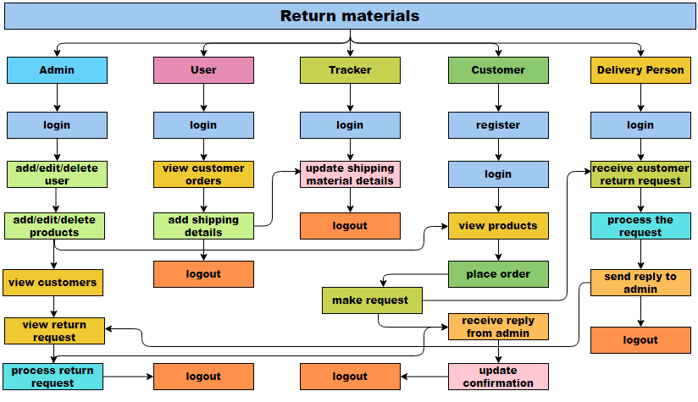
PROJECT FLOW

Slide 12
PROPOSED SYSTEM
Systems for managing return materials can assist in automating and streamlining a variety of processes, including receiving, handling, and dispatching goods, which can boost production and efficiency. By automating manual operations and giving real-time data on inventory levels, shipping schedules, and other topics, return materials management systems can help to decrease errors and enhance accuracy.

Slide 13
ADVANTAGES
Streamlined and User-Friendly Process
Tracking and Transparency
Efficient Communication and Coordination
4. Centralized Management

Slide 14
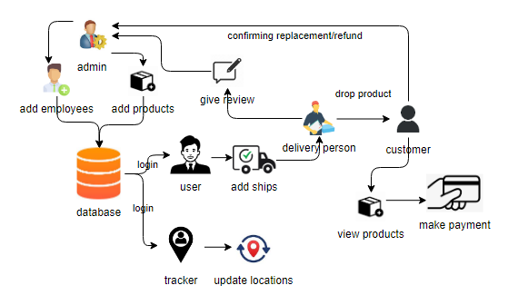
ARCHITECTURE

Slide 15
Implementation:
Admin: Operation – Login: The admin will login the page to enter the project.
Operation – Add: Admin will add users, tracker, delivery person and products.
Operation – View dash board: Admin can view all ships and orders placed by customers.
View review: admin will view the review of received products (damaged).
Operation – Response status: In this section admin can ask the customer for refund or replacement of damaged product.
Operation – Logout: The admin will logout once after users’ confirmation.

Slide 16
2. User Module
Login: User can login with valid credentials.
Add ships: User will add all ships.
Logout: The user will logout after adding ships.
3. TRACKER:
Login: Tracker will login with valid credentials provided by admin.
Update status: After shipment with the help of tracking data tracker will update the milestones of shipment has passed from the starting point to the destination and where a freight shipment or another delivery is currently located.
Logout: The tracker will logout after updating.

Slide 17
Register: Customer should register with their personal details such as name, email, password, phone number, address.
Login: Customer must register with valid credentials (email, password).
View Dashboard: Customer can view all ships from dashboard.
View products: In this section customer can view all products.
Place order: After gone through the all products customer can place order with their selected product and will make payment.
Tracking: After order placement, customer can track their product movement location.
Status: After receiving the ordered product he/she will check that product if it is damaged him will inform to delivery person.
Confirmation: Here customer will confirm about refund or replacement of his/her damaged product.

Slide 18
DELIVERY PERSON:
Operation – Login: Tracker will login with valid credentials provided by admin.
Operation – Give review: After dropping product based on customer review delivery person can send review to admin about received damaged product.

Slide 19
HARDWARE & SOFTWARE REQUIREMENTS
H/W CONFIGURATION:
Processor I3/Intel Processor
Hard Disk 160GB
Key Board Standard Windows Keyboard
Mouse Two or Three Button Mouse
Monitor SVGA
RAM 4Gb

Slide 20
HARDWARE & SOFTWARE REQUIREMENTS
S/W CONFIGURATION:
Operating System : Windows 7/8/10
Programming Language : Python
IDE/Workbench : VS Code
Database : Mysql
Clint Side : React js

Slide 21
REFERENCES
1. Zhang, Y., & Wang, X. (2020). "E-commerce returns: A review of the literature and future research directions." *Journal of Business Research*, 113, 203-213.
2. Kumar, A., & Singh, R. (2019). "Impact of communication on customer satisfaction in e-commerce." *International Journal of Retail & Distribution Management*, 47(1), 112-128.
3. Wang, Y., & Zhang, X. (2021). "Return policies in e-commerce: Effects on customer trust and loyalty." *Journal of Retailing and Consumer Services*, 59, 102410.
4. Li, H., & Wang, J. (2020). "The role of logistics in e-commerce returns: A service quality perspective." *International Journal of Logistics Management*, 31(4), 811-831.
5. Chopra, S., & Meindl, P. (2019). "Supply Chain Management: Strategy, Planning, and Operation." *Pearson Education*.
6. Bhatti, A., & Sahu, A. (2020). "E-commerce returns management: A systematic literature review." *Journal of Retailing and Consumer Services*, 54, 102023.

Slide 22
REFERENCES
7. Awan, U., & Majeed, A. (2021). "Enhancing customer experience through effective return management in e-commerce." *International Journal of Information Systems and Change Management*, 13(1), 37-50.
8. Rao, P., & Goldsby, T. J. (2020). "Improving return processes through integrated technology solutions." *Supply Chain Management: An International Journal*, 25(3), 357-370.
9. Mishra, D., & Singh, R. (2022). "Digital transformation in logistics: Implications for customer returns management." *Journal of Business Logistics*, 43(2), 186-205.
10. Huang, Y., & Benyoucef, M. (2018). "User acceptance of e-commerce websites: A systematic literature review." *Internet Research*, 28(5), 1198-1225.

